Slide 1

Business Idea proposal
Quantcast Q_{next}
Diversification into new areas in our own ecosystem
Sushant Jhingan Feb xx , 2020
Acknowledgement : HW and Display inputs from
Ravi Joshi https://www.linkedin.com/in/ravi-joshi-9924a94/
Notes:
As organisations keeps looking for new business possibilities here is a proposal with potential to take Quantcast in same league as Uber/Amazon/Airbnb etc.

Slide 2

Q_{next} : The Uber , Amazon , Airbnb
Of advertising / Publishing
Notes:
I have taken liberty to name the aggregator platform product as Qnext but business can choose any other appropriate name.
Qnext will be a Software platform working closely with a SBC based Hardware to provide Aggregator functionality to Advertisers / Publishers and the Target Viewers.

Slide 3


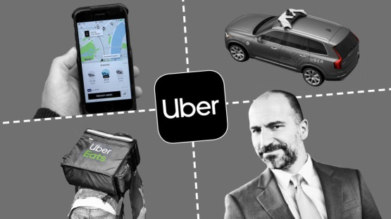
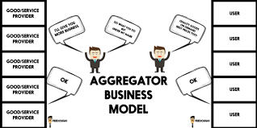
The common thread
Notes:
All these are operating Aggregator platforms. They need not invest into Taxi fleet or Goods to be sold or Houses to be put on short term rent.
Uber Taxi owners own and manage the fleet . Uber provides aggregator platform providing convenience and benefits to taxi users as well as taxi fleet owners with high level of optimization for resource utilization
Amazon in a way is aggregator of goods to be sold by “sellers ‘ towards the consumers/ Customers. Goods to be sold are owned and managed by sellers.
Houses for short period renting are owned and managed by House owners . Airbnb brings convenience and benefits to both renter and people needing short period accommodation. Again Optimization is the key word
We at Quatcast do operate between the advertisers/publishers and website owners. We are not in aggregator-platform-space between viewer and publisher. We do provide business analytics for benefit of advertiser/publisher

Slide 4


Quantcast Intelligence Cloud, powered by Q
Discover new customers,
Drive incremental growth
Deliver business outcomes.
Marketers
Publishers
Agencies
Consultancies
Content Consumer
Content Provider
New Business : Be an Aggregator between Advt. Content and Advt. Consumer
Notes:
Quantcast operates between the content viewer and the advertiser publisher and provides business intelligence for discovery of new customers , drive business growth and business outcomes towards the Publishers , Agencies and Consultancies.
But content is not only published through webpages of computers / mobile devices . We see all kind of advertising displays around us. On roads , in shopping malls , Cinema halls, Lobbies etc. Currently Advertising agencies manage the tasks of bringing together Display space owners and Advertisers . Display space ownership is largely locally controlled.
An aggregator platform is the most appropriate solution in this space where a suitable aggregator platform can disrupt current bussines model and provide complete convenience of managing the complete bussiness chain .

Slide 5
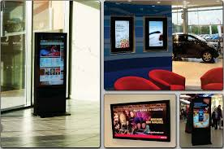
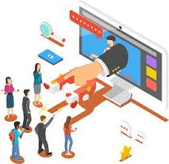


Q_{next} : Aggregator platform between Advertisers
and Advertising displays with AI benifits
Advt. Displays
Advt. Content
Notes:
Caution : The term Display here denotes Physical large size display e.g LED outdoor display, LCD panels for In-door display. This is not meaning same as convention in Quantcast.
Qnext provides a Aggregator platform to advertiser for uploading and scheduling the content on selected advertising displays. To display owners it provides possibility of advertising their Display capability , location , Footfall/Eye-Ball statistics to “sale” their advertising display time slots to advertisers
As an aggregator Qnext provides a online interface to Advertisers and Display owners with value add in the form of providing verification capabilities and business intelligence through viewer / eye-ball statistics through image analytics.

Slide 6
Q_{next} : Aggregator platform
Display owner:
Owns and manages the displays and the Display installation at site for advertising revenue
Receives bookings and Advertising revenue through aggregator
Advertiser:
Companies , Publishers, Advertisers : Provides content , Selects Displays and schedule and pays for advertising
Aggregator: Q_{next}
Provides online platform for uploading and scheduling content
Provides online information about available Displays , schedules and rates from display owners and AI based consumer analytics
Provides and controls HW interface between Qnext Servers and displays
Uber , Amazon , Airbnb etc.
Notes:
Displays and their sites being a very locally manageable issue, it is best left to the display owners to hire the installtion space and the buy, install and manage displays (just like a House on Airbnb ) .
We provide a platform where these display owners to advertise these displays to attract potential advertisers who in turn will be paying for the advertisements being run on these displays.
They also need to buy our Hardware+Software platform which will have a mobile data interface to Qnext server and HDMI interface towards the display. Our revenue model could be a % of advt revenue for Display owner.
Currently contents on advertising displays is largely managed by advertising Agencies , who are well entrenched in the eco system managing the Content creation as well as advertisement space renting. But this can be disruppted just like Airbnb did to Hotels, Uber did to Taxi bussineses and Amazon did to calssical shop models.
Quantcast can provide teremendous value add in the from of its expertise in bussiness analytics .

Slide 7
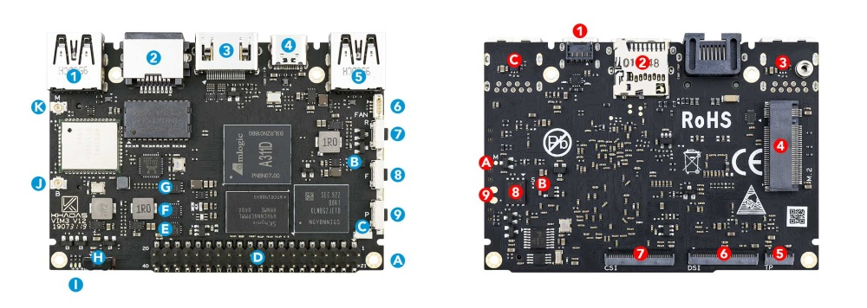
Q_{next} : Hardware platform
Hardware:
Single Board Computer with Mobile data connectivity for content and schedule upload . e.g. Khadas Vim3 HW extended with Mobile connectivity and Object detections and other analytics
Player for content files e.g. VLC player
4K@ 60 Hz HDMI output for connection to Display
2x Camera Interface for Viewer detection and Content Played
Scheduled play verification
Running AI and ML based models for Consumer profiling and business analytics without compromising privacy laws . Khadas Vim3 HW has 5.0 TOPS NPU inbuilt
Easily possible from third party developers at < 100 USD . High Volumes may bring the cost down to < 50 USD. Cost to be borne by Display Owner
Notes:
These days many advance single board computers and simple mobile phones show great capabilities at low cost. Amlogic Khadas VIM 3 SBC have Neural Processing Unit for A.I. and can run Next generation, deep-neural-network applications, at 5.0 TOPS
https://www.khadas.com/vim3
A Nvidia Jetson Nano can run multiple neural networks in parallel for applications like image classification, object detection, segmentation, and speech processing. Can interface with Camera modules.
Cheap mobile phone hardware can have camera interfaces , and high resolution display driving capabilities.
With further exploration a hardware interface can be developed through third parties to provide all necessary functionalities at low cost.
We can develop business intelligence capabilities over the images captured of viewers in front of the display to generate eye-ball capture statistics with object detection and analysis modules

Slide 8
Q_{next} : Software platform
Software:
Provides interface for Display owners to upload their Display capabilities, Site/ Location information, Footfall v/s time of day statistics, Advertising rates for different time slots etc. and Real Time Bidding
Payment module towards Display owner from Advt Revenue
Provides Search & Selection module for advertisers to see and select available displays
Upload advertising content files to be played
Schedule upload
Payment module from Advertiser side.
Verification Module providing advertisers possibility of random check if scheduled content is indeed played at scheduled time slots
AI analytics module anlaysing camera images, capturing Viewer and eye-ball count statistics and make it available to Advertiser as well as Display owner to calibrate advertising rates for different time slots per display

Slide 9

Q_{next} : The next great business idea for Quantcast

Slide 10
POC : initial trial possibilities
Display side application
Android application running of current generation of Android mobile phone can be used to verify following conceprt
Video files / Streams down load to phone
Scheduler down laod on the phone
Control of front camera for verification for advertiser regarding right content played at scheduled time slot
Back side Camera to capture video. A ML model generating statistics of viewers and eye-ball capture. Only statistics to be further passed. Video stream may create privecy concerns.
Serverside Applications
Secure transfer of video and schedule to Display side HW
Log in , site and schedule selection, Video upload , RTB and Payment receiving for advertiser
Log in, Site/Display capability exposure and min bid rates for time slots

